Slide 1
FILIET: An information extraction system for Filipino disaster-related tweets
Proponents
Dela Cruz, Kyle Mc Hale B.
Garcia, John Paul F.
Kalaw, Kristine Ma. Dominique F.
Lu, Vilson E.
Thesis Adviser
Regalado, Ralph Vincent J.

Slide 2
Overview of the Current State of Technology
Objectives & Scope and Limitations
Theoretical Framework
Outline

Slide 3
Overview of the FILIET System
Objectives and Scopes & Limitation of the System
Design and Implementation
Outline

Slide 4
Results and Observations
Conclusions and Recommendations
Outline

Slide 5
RESEARCH
A DISCUSSION OF THE

Slide 6
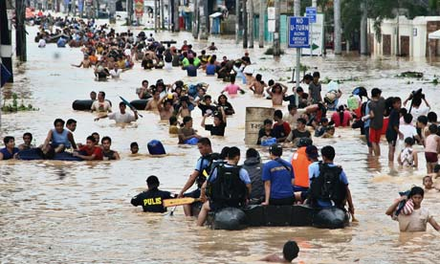

“about 2 million people died and an estimate of US$ 1.7 trillion of damage were sustained in disasters…”
Overview of the Current State of Technology

Slide 7

The
Philippines
is considered as
“Social Media Capital of the World”
Overview of the Current State of Technology

Slide 8

Twitter, a popular microblogging platform where users can post statuses in real-time, is used to share information regarding the disaster as well as response efforts.
Overview of the Current State of Technology

Slide 9

The PH government has released an official newsletter indicating the official social media accounts and unified hashtags to help in the disaster relief effort.
Overview of the Current State of Technology

Slide 10
Social Media Data
Information Extraction Module
Type, date and time, and location of the disaster
SOMIDIA
Overview of the Current State of Technology

Slide 11
Problems
Filipino Extraction Module vs. English Extraction Module
Filipino: Morphologically Rich Language
Variations in the Filipino Language
Overview of the Current State of Technology

Slide 12
General Objective
“To develop an information extraction system that extracts relevant information from disaster-related texts from social media and takes into consideration the different available variations in the Filipino language.”
The Objectives & Scope and Limitations of the Research

Slide 13
Specific Objectives – Scope and Limitations
To review different information extraction systems in morphologically rich languages.
Review of various information extraction systems that extract information.
To understand the different approaches (i.e. architectures, implementation, and components) of implementing an information extraction system.
The Objectives & Scope and Limitations of the Research

Slide 14
Specific Objectives – Scope and Limitations
To identify data source that will be used for the information extraction system.
Example of data source: Facebook and Twitter.
Identifying the data source that will be used in the information extraction will help in choosing appropriate pre-processing techniques and algorithms.
The Objectives & Scope and Limitations of the Research

Slide 15
Specific Objectives – Scope and Limitations
To review different natural language processing techniques that will pre-process data for the information extraction system.
Examples of the NLP techniques: text classification and text normalization.
The Objectives & Scope and Limitations of the Research

Slide 16
Specific Objectives – Scope and Limitations
To review different information extraction techniques.
Examples of IE techniques: Named Entity Recognition (NER), lexical analysis, and coreference analysis.
The Objectives & Scope and Limitations of the Research

Slide 17
Specific Objectives – Scope and Limitations
To evaluate existing tools and resources which could be incorporated in the information extraction components of the system.
Existing tools that will be used in building the information extraction system will be reviewed and evaluated.
Examples of NLP tools:
OpenNLP and LingPipe.
The Objectives & Scope and Limitations of the Research

Slide 18
Specific Objectives – Scope and Limitations
To determine the metrics for evaluating the information extraction system.
In order to evaluate the information extraction system, the research will determine the metrics to measure the system’s performance.
The Objectives & Scope and Limitations of the Research

Slide 19
Information Extraction
Information extraction is the identification of class of events or relationship and the extraction of relevant arguments of the event or relationship inside a natural language (Grisham, 1997).
Theoretical Framework

Slide 20
Information Extraction Modules
TEXT CLASSIFICATION
TOKENIZER
LEMMATIZER
SENTENCE SPLITTER
NORMALIZER
COREFERENCE RESOLUTION
POS TAGGER
GAZETTEER
NAMED ENTITY RECOGNITION
Theoretical Framework

Slide 21
Information Extraction Systems
EXTRACTING INFORMATION NUGGETS FROM
DISASTER-RELATED MESSAGES IN SOCIAL MEDIA
PRACTICAL EXTRACTION OF DISASTER-RELEVANT INFORMATION FROM SOCIAL MEDIA
Imran, Elbassuoni, Castillo, Diaz, & Meier (2013)
Imran, Elbassuoni, Castillo, Diaz, & Meier (2013)
Theoretical Framework

Slide 22
Information Extraction Systems – Machine Learning-Based
MACHINE LEARNING FOR INFORMATION EXTRACTION IN INFORMAL DOMAINS
A MACHINE LEARNING APPROACH TO INFORMATION EXTRACTION
LEARNING IE RULES FOR A SET OF RELATED CONCEPTS
Freitag (2000)
Téllez, Montes-y-Gómez, & Villaseñor-Pineda (2005)
Turmo & Rodriguez (2000)
Theoretical Framework

Slide 23
Information Extraction Systems – Rule-Based
BUSINESS SPECIFIC ONLINE INFORMATION EXTRACTION FROM GERMAN WEBSITES
INFORMATION EXTRACTION FOR VIETNAMESE REAL ESTATE ADVERTISEMENTS
Lee & Geierhos (2009)
Pham, L. & Pham, S. (2012)
Theoretical Framework

Slide 24
Information Extraction Systems – Template/Ontology-Based
AN OPEN ARCHITECTURE FOR MULTI-DOMAIN INFORMATION EXTRACTION
ONTOLOGY-BASED INFORMATION EXTRACTION FOR FRENCH NEWSPAPER ARTICLES
Poibeau (2014)
Nebhi (2012)
Theoretical Framework

Slide 25
Information Extraction Systems – Adaptive-Based
ADAPTIVE INFORMATION EXTRACTION
SOCIAL MEDIA MONITORING FOR DISASTERS
Turmo, Ageno & Català (2006)
Cheng, Chua, Co & Magpantay (2012)
Theoretical Framework

Slide 26
SYSTEM
A DISCUSSION OF THE

Slide 27
Filipino Information Extraction for Twitter (FILIET) is an information extraction system that incorporates the architectures of a rule-based IE system for Filipino disaster related reports.
Overview of the FILIET System

Slide 28
General Objective
To develop an information extraction system that extracts relevant information from disaster-related texts from Twitter data and takes into consideration the different available variations of the Filipino language.
The Objectives & Scope and Limitations of the System

Slide 29
Specific Objective – Scope and Limitations
To develop an information extraction system that extracts relevant information from disaster-related texts from Twitter data and takes into consideration the different available variations of the Filipino language.
The Objectives & Scope and Limitations of the System

Slide 30
Specific Objectives – Scope and Limitations
To be able to preprocess the tweets.
Text Normalization
Text Tokenization
POS Tagging
NER
The Objectives & Scope and Limitations of the Research

Slide 31
Specific Objectives – Scope and Limitations
To be able to extract relevant features from the tweets.
Presence Features
Tweet Length
Word Features
The Objectives & Scope and Limitations of the Research

Slide 32
Specific Objectives – Scope and Limitations
To classify the tweets according to their content.
Caution and Advice
Casualties and Disasters
Donation
Call For Help
Others
The Objectives & Scope and Limitations of the Research

Slide 33
Specific Objectives – Scope and Limitations
To extract the relevant information according to the type of tweet.
Caution and Advice – Advice, Location
Casualties and Disasters – Object, Details, Location
Donation – Object, Details, Victim Name, Location
Call For Help – Victim Name, Location
Others
The Objectives & Scope and Limitations of the Research

Slide 34
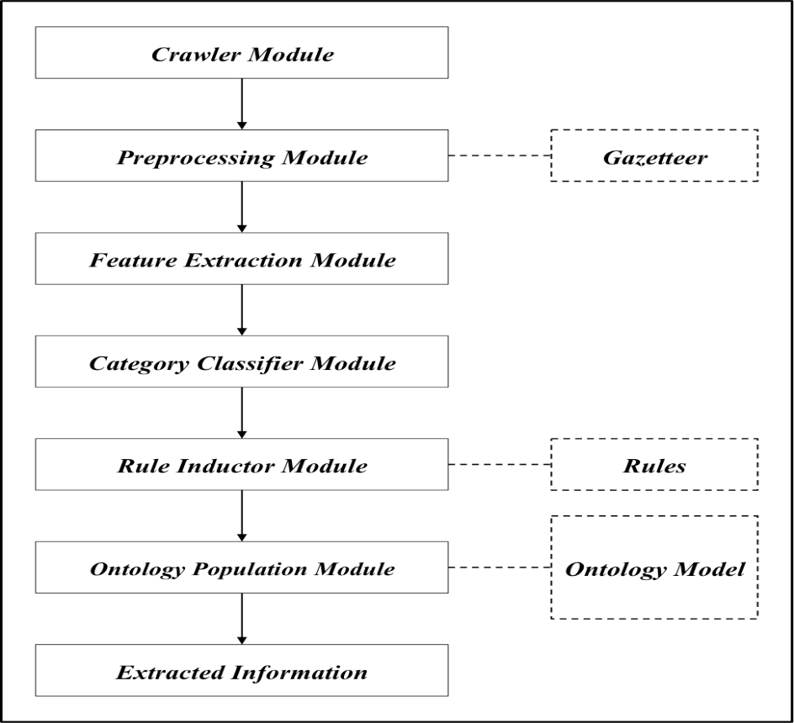
Architecture
Design and Implementation
Figure 4‑1. FILIET Architectural Design

Slide 35
Architecture – Crawler Module
The crawler module collects tweet from Twitter
// Filters
FilterQuery fq = new FilterQuery();
String keywords[] = {"#reliefPH","#nopower", "#nowater", "#roadalert", "#tracingPH", "#rescuePH", "#floodPH", "#queenieph"};
fq.track(keywords);
TwitterStream tweetStream = twitterStreamFactory.getInstance();
tweetStream.addListener(listener);
tweetStream.filter(fq);
Design and Implementation
Figure 4‑1. FILIET Architectural Design

Slide 36
Architecture – Preprocessing Module
Text Norrmalizer
Tokenizer
POS Tagger
NER
Design and Implementation
Figure 4‑1. FILIET Architectural Design

Slide 37
Architecture – Preprocessing Module (Text Normalizer)
The text normalizer cleans the tweets by normalizing the text.
// Norm API
String normalizedText = NormAPI.normalize_Text(shortcutText);
// Implementation
normalizer = new Normalizer(new NormApiImpl());
normalizedTweet = normalizer.executeStrategy(text);
Design and Implementation
Figure 4‑1. FILIET Architectural Design

Slide 38
Architecture – Preprocessing Module (Tokenizer)
The tokenizer takes a tweet and parses them into tokens.
// NormAPI Implementation
String normalizedText = NormAPI.normalize_Text(shortcutText);
// Usage
normalizer = new Normalizer(new NormApiImpl());
normalizedTweet = normalizer.executeStrategy(text);
Design and Implementation
Figure 4‑1. FILIET Architectural Design

Slide 39
Architecture – Preprocessing Module (POS Tagger)
The POS Taggers tags the tokens with its corresponding Part-Of-Speech
// POS Tagger Implementation
POSTagger post = new POSTagger(new POSHashLookupImpl());
// Usage
tokens = post.executeStrategy(tokens);
Design and Implementation
Figure 4‑1. FILIET Architectural Design

Slide 40
Architecture – Preprocessing Module (NER)
The NER tagger will identify the proper nouns (location) in the tweets.
// POS Tagger Implementation
NamedEntityRecognizer ner = new NamedEntityRecognizer (new SomidiaNERImpl());
// Usage
tokens = ner.executeStrategy(tokens);
Design and Implementation

Slide 41
Architecture – Feature Extraction Module
The feature extractor module is for extracting word features, presence features, and tweet length of a tweet.
// initialization
String word = "./resources/model/word/ruby-word";
FeatureExtractor fe = new FeatureExtractor(word);
// Single Processing
fe.extract(sentence);
// Batch Processing
String tweets = "./resources/tweets/mario-datasets/original/ruby-dataset.csv”;
String saveModel = "./resources/tweets/test-extracted/mario-tfidf/ruby-extracted.csv
fe.extractFeatures(tweets,saveModel);
Design and Implementation
Figure 4‑1. FILIET Architectural Design

Slide 42
Architecture – Feature Extraction Module
The classifier module categorizes the tweet into one of the following categories: Caution and Advice (CA), Casualties and Damage (CD), Donation (D), Call for Help (CH), and Other (O).
// Single Classifier
Classifier classifier = new Classifier(new ClassifierImpl());
// Multi Classifier
Classifier classifier = new Classifier(new MultiClassifierImpl());
// Usage
String category = classifier.executeStrategy(temp);
Design and Implementation
Figure 4‑1. FILIET Architectural Design

Slide 43
Architecture – Information Extractor Module
The Information extractor is the module extracts the relevant information from the tweets.
RuleInductor ruleInductor = new RuleInductor(rulePath);
ruleInductor.setExtractedInformation(ruleInductor.match( extractedTweet ));
Design and Implementation
Figure 4‑1. FILIET Architectural Design

Slide 44
Architecture – Information Extractor Module
<Category>: CA
<pos:JJ> <pos:NN> <pos:PSNS> <number:ANY>
<ner:LOCATION>[as]LOCATION
<pos:JJ> <string:#1>
<pos:JJ> <string:#2>
<pos:JJ> <string:#3>
<pos:VBZ> <string:classes> <pos:IN> <pos:JJ> <pos:VBZ>
<pos:VBP> <string:classes> <pos:IN> <pos:JJ> <pos:VBZ>
<string:#walangpasok> <pos:JJ> <pos:VBZ>
<string:signal> <pos:NN> <pos:PSNS> <number:ANY>
<string:#walangpasok> <pos:PSNS> <string:klase>
<string:#walangpasok> <string:sa> <pos:PIDP> <pos:NA> <string:antas>
<end>
Design and Implementation
Figure 4‑1. FILIET Architectural Design

Slide 45
Architecture – Ontology Population Module
The ontology population module stores the extracted in the ontology
// Sample initialization for caution and advice reports
oCA.setTweetHandle("theonlykyleeeee");
oCA.setTweetContent(":(( RT WARNING! Baha sa Guadalupe!");
oCA.setTweetGeoLocation("10.00000121, 145.345300023");
oCA.setLocationInTweet("Guadalupe");
oCA.setTweetTimestamp("12/27/2014:00:13:67:40");
oCA.setTweetDate("December 27, 2014");
oCA.setTweetAdvice("WARNING! Baha sa Guadalupe!");
// Population
oModule.loadOntology();
oModule.addCautionAndAdviceReport(oCA);
Design and Implementation
Figure 4‑1. FILIET Architectural Design

Slide 46
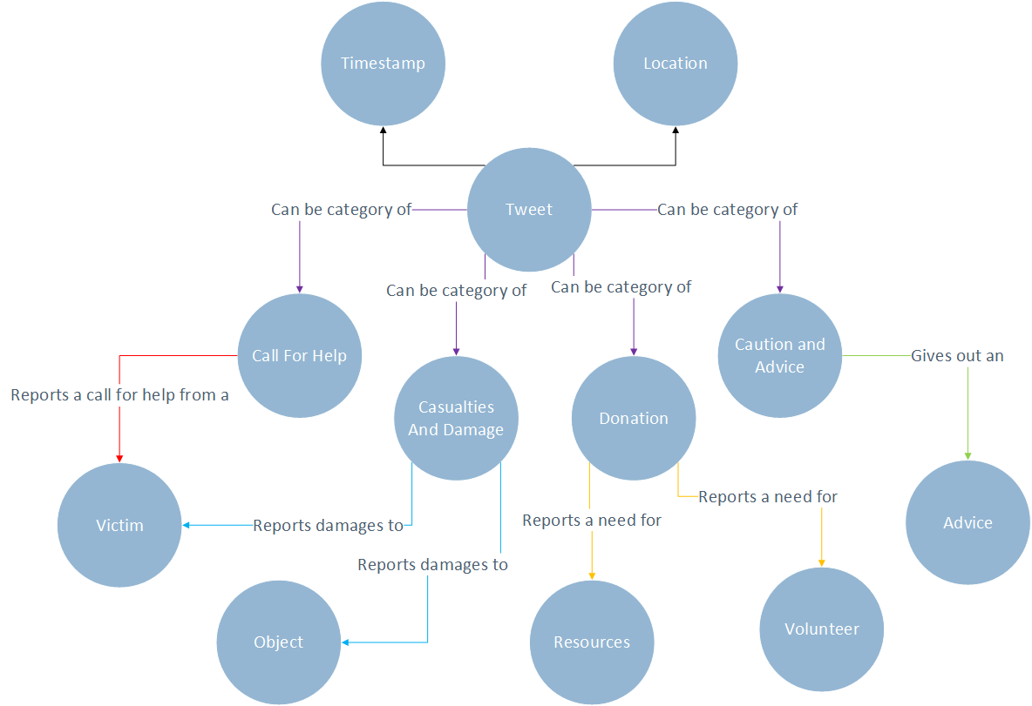
Architecture – Ontology Module
Design and Implementation

Slide 47
RESULTS
A DISCUSSION OF THE

Slide 48
Evaluation of Features - Methodology
Ruby Dataset
Category | Instances
Caution and Advice | 1279
Casualties and Damages | 45
Donation | 37
Call For Help | 9
Others | 1013
Total | 2583
Mario Dataset
Category | Instances
Caution and Advice | 651
Casualties and Damages | 99
Donation | 47
Call For Help | 38
Others | 510
Total | 1365
Results and Observations

Slide 49
Evaluation of Features - Methodology
Settings
Ranking Method | TFIDF Scores
Number of Features | 10%, 20% and 30%
Algorithms | Random Forest, J48, k-NN (k = 3, 5, 7), Naïve Bayes, Bayesian Network
Evaluation | 10 cross-fold validation
Results and Observations

Slide 50
Evaluation of Features (Mario Features – Mario Dataset)
 | 10% |  |  |  | 20% |  |  |  | 30%
 | P | R | FM | K | P | R | FM | K | P | R | FM | K
J48 | 0.79 | 0.777 | 0.776 | 0.6424 | 0.761 | 0.75 | 0.751 | 0.5976 | 0.817 | 0.804 | 0.804 | 0.6848
RF | 0.816 | 0.813 | 0.813 | 0.7011 | 0.774 | 0.769 | 0.77 | 0.6281 | 0.857 | 0.846 | 0.847 | 0.7533
KNN3 | 0.756 | 0.749 | 0.75 | 0.6018 | 0.739 | 0.735 | 0.736 | 0.5714 | 0.798 | 0.778 | 0.778 | 0.6457
KNN5 | 0.771 | 0.758 | 0.758 | 0.6114 | 0.732 | 0.725 | 0.726 | 0.5515 | 0.813 | 0.78 | 0.78 | 0.6475
KNN7 | 0.781 | 0.761 | 0.761 | 0.6151 | 0.726 | 0.716 | 0.716 | 0.532 | 0.803 | 0.764 | 0.762 | 0.6203
NB | 0.73 | 0.729 | 0.728 | 0.5616 | 0.742 | 0.728 | 0.727 | 0.5712 | 0.758 | 0.741 | 0.742 | 0.5923
BN | 0.726 | 0.716 | 0.714 | 0.5308 | 0.735 | 0.729 | 0.728 | 0.5552 | 0.776 | 0.765 | 0.764 | 0.6179
Results and Observations

Slide 51
Evaluation of Features (Ruby Features – Ruby Dataset)
 | 10% |  |  |  | 20% |  |  |  | 30%
 | P | R | FM | K | P | R | FM | K | P | R | FM | K
J48 | 0.901 | 0.899 | 0.898 | 0.8279 | 0.914 | 0.914 | 0.913 | 0.8527 | 0.927 | 0.926 | 0.925 | 0.8746
RF | 0.917 | 0.916 | 0.916 | 0.8579 | 0.933 | 0.933 | 0.933 | 0.8862 | 0.952 | 0.951 | 0.951 | 0.9165
KNN3 | 0.901 | 0.901 | 0.899 | 0.8301 | 0.918 | 0.917 | 0.916 | 0.8572 | 0.928 | 0.922 | 0.921 | 0.8666
KNN5 | 0.893 | 0.89 | 0.887 | 0.8113 | 0.917 | 0.916 | 0.915 | 0.8559 | 0.927 | 0.921 | 0.92 | 0.8652
KNN7 | 0.869 | 0.869 | 0.865 | 0.7749 | 0.917 | 0.916 | 0.915 | 0.8559 | 0.927 | 0.921 | 0.92 | 0.8652
NB | 0.866 | 0.865 | 0.864 | 0.7687 | 0.876 | 0.868 | 0.87 | 0.7807 | 0.9 | 0.898 | 0.898 | 0.8286
BN | 0.858 | 0.858 | 0.856 | 0.756 | 0.887 | 0.887 | 0.887 | 0.8082 | 0.903 | 0.903 | 0.902 | 0.8355
Results and Observations

Slide 52
Evaluation of Features (Ruby Features – Mario Dataset)
 | 10% |  |  |  | 20% |  |  |  | 30%
 | P | R | FM | K | P | R | FM | K | P | R | FM | K
J48 | 0.711 | 0.718 | 0.71 | 0.5368 | 0.78 | 0.773 | 0.772 | 0.6345 | 0.803 | 0.793 | 0.794 | 0.6691
RF | 0.748 | 0.753 | 0.749 | 0.601 | 0.804 | 0.8 | 0.8 | 0.68 | 0.841 | 0.837 | 0.838 | 0.738
KNN3 | 0.706 | 0.711 | 0.707 | 0.5288 | 0.766 | 0.763 | 0.763 | 0.62 | 0.771 | 0.768 | 0.768 | 0.6278
KNN5 | 0.682 | 0.684 | 0.681 | 0.4818 | 0.741 | 0.736 | 0.736 | 0.5747 | 0.746 | 0.741 | 0.74 | 0.5784
KNN7 | 0.666 | 0.666 | 0.662 | 0.4498 | 0.724 | 0.72 | 0.718 | 0.5448 | 0.732 | 0.722 | 0.722 | 0.5478
NB | 0.662 | 0.678 | 0.669 | 0.4728 | 0.75 | 0.738 | 0.736 | 0.583 | 0.747 | 0.732 | 0.731 | 0.574
BN | 0.666 | 0.687 | 0.667 | 0.4691 | 0.746 | 0.737 | 0.734 | 0.5741 | 0.754 | 0.742 | 0.741 | 0.5862
Results and Observations

Slide 53
Evaluation of Features (Mario Features – Ruby Dataset)
 | 10% |  |  |  | 20% |  |  |  | 30%
 | P | R | FM | K | P | R | FM | K | P | R | FM | K
J48 | 0.892 | 0.898 | 0.893 | 0.8255 | 0.872 | 0.874 | 0.872 | 0.7858 | 0.906 | 0.909 | 0.907 | 0.8455
RF | 0.917 | 0.918 | 0.917 | 0.8607 | 0.895 | 0.895 | 0.895 | 0.8223 | 0.939 | 0.939 | 0.938 | 0.8968
KNN3 | 0.89 | 0.891 | 0.89 | 0.8154 | 0.881 | 0.882 | 0.88 | 0.7987 | 0.912 | 0.912 | 0.911 | 0.8496
KNN5 | 0.88 | 0.883 | 0.88 | 0.8003 | 0.871 | 0.872 | 0.869 | 0.7811 | 0.898 | 0.901 | 0.898 | 0.8306
KNN7 | 0.859 | 0.864 | 0.861 | 0.7694 | 0.85 | 0.855 | 0.851 | 0.751 | 0.876 | 0.88 | 0.877 | 0.794
NB | 0.841 | 0.843 | 0.841 | 0.732 | 0.831 | 0.817 | 0.822 | 0.6973 | 0.877 | 0.866 | 0.87 | 0.7789
BN | 0.845 | 0.847 | 0.844 | 0.738 | 0.826 | 0.82 | 0.821 | 0.699 | 0.875 | 0.867 | 0.87 | 0.7793
Results and Observations

Slide 54
Evaluation of Features - Methodology
Ruby Dataset
Category | Instances
Caution and Advice | 1279
Casualties and Damages | 45
Donation | 37
Call For Help | 9
Others | 1013
Total | 2583
Mario Dataset
Category | Instances
Caution and Advice | 651
Casualties and Damages | 99
Donation | 47
Call For Help | 38
Others | 510
Total | 1365
Results and Observations

Slide 55
Evaluation of Classifier – Single (Mario)
 | Precision | Recall | F-measure | Kappa
J48 | 0.817 | 0.804 | 0.804 | 0.6848
Random Forest | 0.857 | 0.846 | 0.847 | 0.7533
KNN-3 | 0.798 | 0.778 | 0.778 | 0.6457
KNN-5 | 0.813 | 0.78 | 0.78 | 0.6475
KNN-7 | 0.803 | 0.764 | 0.762 | 0.6203
Naive Bayes | 0.758 | 0.741 | 0.742 | 0.5923
Bayesian Network | 0.776 | 0.765 | 0.764 | 0.6179
Results and Observations

Slide 56
Evaluation of Classifier – Single (Ruby)
 | Precision | Recall | F-measure | Kappa
J48 | 0.906 | 0.909 | 0.907 | 0.8455
Random Forest | 0.939 | 0.939 | 0.938 | 0.8968
KNN-3 | 0.912 | 0.912 | 0.911 | 0.8496
KNN-5 | 0.898 | 0.901 | 0.898 | 0.8306
KNN-7 | 0.876 | 0.88 | 0.877 | 0.794
Naive Bayes | 0.877 | 0.866 | 0.87 | 0.7789
Bayesian Network | 0.875 | 0.867 | 0.87 | 0.7793
Results and Observations

Slide 57
Evaluation of Classifier – Multiple(Ruby)
 | CA | CD | CH | D | O | Precision | Recall | F-measure
CA | 644 | 36 | 133 | 6 | 460 | 0.387019 | 0.503518 | 0.437649
CD | 176 | 4 | 20 | 0 | 45 | 0.029412 | 0.016327 | 0.020997
CH | 7 | 0 | 1 | 0 | 1 | 0.003922 | 0.111111 | 0.007576
D | 28 | 0 | 4 | 0 | 5 | 0 | 0 | 0
O | 809 | 96 | 97 | 1 | 10 | 0.019194 | 0.009872 | 0.013038
Results and Observations

Slide 58
Evaluation of Classifier – Multiple (Mario)
 | CA | CD | CH | D | O | Precision | Recall | F-measure
CA | 391 | 81 | 126 | 6 | 47 | 0.408568 | 0.600614 | 0.486318
CD | 47 | 0 | 8 | 0 | 3 | 0 | 0 | 0
CH | 63 | 2 | 26 | 8 | 0 | 0.125604 | 0.262626 | 0.169935
D | 30 | 11 | 3 | 0 | 3 | 0 | 0 | 0
O | 426 | 37 | 44 | 0 | 3 | 0.053571 | 0.005882 | 0.010601
Results and Observations

Slide 59
Evaluation of Information Extraction - Methodology
Ruby Dataset
Category | Instances
Caution and Advice | 1279
Casualties and Damages | 45
Donation | 37
Call For Help | 9
Others | 1013
Total | 2583
Mario Dataset
Category | Instances
Caution and Advice | 651
Casualties and Damages | 99
Donation | 47
Call For Help | 38
Others | 510
Total | 1365
Results and Observations

Slide 60
Evaluation of Information Extraction - Methodology
$$Precision= \frac{Correct+ \frac{1}{2}(Partial)}{Correct+Spurious+Partial}$$
$$Recall= \frac{Correct+ \frac{1}{2}(Partial)}{Correct+Missing+Partial}$$
$$F−measure= \frac{2 ×Precision×Recall}{Precision+Recall}$$
Results and Observations

Slide 61
Evaluation of Information Extraction – CA (Location)
Ruby
Correct | Spurious | Partial | Missing
2987 | 330 | 814 | 3819
Precision | 0.8216
Recall | 0.4454
F-measure | 0.5777
Mario
Correct | Spurious | Partial | Missing
357 | 119 | 199 | 806
Precision | 0.6762
Recall | 0.3352
F-measure | 0.4482
Results and Observations

Slide 62
Evaluation of Information Extraction – CA (Location)
Tweet | Actual | Extracted
RT @meralco: Paalala: Bago pasukin ng baha ang bahay, patayin ang circuit breaker upang makaiwas sa aksidente. #RubyPH http://t.co/i5iBuBFnÃ¢â‚¬Â¦ | <none> | Bago
RT @DZMMTeleRadyo: Palibot ng SM Manila at Manila City Hall, may gutter deep na baha #MarioPH http://t.co/G4CK8xEsuW... http://t.co/LwM3cniÃ¢â‚¬Â¦ | SM Manila at Manila City Hall | may Manila Manila City
PHOTO: Maulap ngayon sa Legaspi City Albay; Bulkang Mayon, halos di matanaw http://t.co/Ed40WbLeH9 via @zhandercayabyab #RubyPH | Legaspi City Albay | Albay Mayon
RT @IMReadyPH: #RubyPH SIGNAL NO. 1: Calamian Group of Islands, Cuyo and Metro Manila | via @dost_pagasa | Calamian Group of Islands, Cuyo, and Metro Manila | Cuyo Manila
RT @DZMMTeleRadyo: Baha sa Monumento, Caloocan, lagpas gutter na partikular sa tapat ng MCU | ulat ni RP35 J. IbaÃƒÂ±ez #MarioPH | Monumento, Caloocan | Caloocan
Results and Observations

Slide 63
Evaluation of Information Extraction – CA (Advice)
Ruby
Correct | Spurious | Partial | Missing
553 | 14 | 1457 | 2248
Precision | 0.6332
Recall | 0.3010
F-measure | 0.4080
Mario
Correct | Spurious | Partial | Missing
413 | 305 | 193 | 898
Precision | 0.5593
Recall | 0.3388
F-measure | 0.4219
Results and Observations

Slide 64
Evaluation of Information Extraction – CA (Advice)
Tweet | Actual | Extracted
RT @IMReadyPH: #RubyPH SIGNAL NO. 1: Calamian Group of Islands, Cuyo and Metro Manila | via @dost_pagasa | Signal No. 1 | Signal 1
Zhander Cayabyab on Twitter: "PHOTO: Abot-dibdib na baha sa Araneta cor. E.Rod QC (padala ni... http://t.co/QNshINlg4Q | Abot-dibdib na baha | baha
Results and Observations

Slide 65
Evaluation of Information Extraction – CD (Location)
Ruby
Correct | Spurious | Partial | Missing
196 | 115 | 7 | 185
Precision | 0.6274
Recall | 0.5142
F-measure | 0.5652
Mario
Correct | Spurious | Partial | Missing
5 | 7 | 21 | 167
Precision | 0.4700
Recall | 0.0803
F-measure | 0.1372
Results and Observations

Slide 66
Evaluation of Information Extraction – CD (Location)
Tweet | Actual | Extracted
TVPatrol #RubyPH nanalasa sa Tacloban, ilang bahay at tent winalis ng bagyo. Ulat ni @rongagalac mula sa Tacloban http://t.co/muFIoUHaL1 | Tacloban | Tacloban Tacloban Tacloban
#TyphoonRuby #24Oras anu na po lates update dito sa province of cavite wala na pu kasing kuryente ang ibang lugar dito #RubyPH | Cavite | dito
#RubyPH PHOTO: 683 pamilya sa Quirangay, Camalig, Albay, nanatili sa evacuation center dahil sa pabugso bugsong... http://t.co/LnlHB0m0JS | Quirangay Camalig Albay | Camalig
"@DZMMTeleRadyo: Bubong at kisame ng Tacloban Airport, sinira ni #RubyPH http://t.co/FZHADakW9X http://t.co/0u0ziXbw9e" grabe | Tacloban Airport | Tacloban
district 2,estero narcisa bgy. 259 tinatayang 150 at 200 n pmilya nman s estero de magdalena ang apektado s bagyong mario.#MarioPH #FloodPH | district 2 estero narcisa bgy. 259 | <none>
RT @DZMMTeleRadyo: Tulay sa CamNorte, nawasak ng baha; Quirino Hiway ang daan pa-Daet (Photo from @PRO5React) http://t.co/l9AopM1Zmy httpÅ â€‿_ | CamNorte | <none>
Results and Observations

Slide 67
Evaluation of Information Extraction – CD (Object Name)
Ruby
Correct | Spurious | Partial | Missing
131 | 99 | 1 | 215
Precision | 0.5693
Recall | 0.3790
F-measure | 0.4550
Mario
Correct | Spurious | Partial | Missing
0 | 1 | 18 | 62
Precision | 0.4737
Recall | 0.1125
F-measure | 0.1818
Results and Observations

Slide 68
Evaluation of Information Extraction – CD (Object Name)
Tweet | Actual | Extracted
RT @News5AKSYON: #AksyonSaHagupit: 10 bahay sa dalampasigan ng Albay, tinangay ng malakas na alon #RubyPH | Ulat ni @edlingao | bahay | 10 bahay
"@gmanews: #RubyPH update mula sa press briefing ng DILG: Walang naitalang casualty sa Leyte." Good to hear. Sana sa ibang lugar din :) | <none> | Walang casualty
RT @DZMMTeleRadyo: PHOTO: Mga establisimyento sa Tacloban, pinapakuan ng plywood kontra baha at alon #RubyPH http://t.co/kAsVyyCCjD | via @Ã¢â‚¬Â¦ | establisimyento | baha alon
Results and Observations

Slide 69
Evaluation of Information Extraction – CD (Object Details)
Ruby
Correct | Spurious | Partial | Missing
51 | 10 | 20 | 392
Precision | 0.7531
Recall | 0.1317
F-measure | 0.2247
Mario
Correct | Spurious | Partial | Missing
0 | 0 | 0 | 155
Precision | 0
Recall | 0
F-measure | 0
Results and Observations

Slide 70
Evaluation of Information Extraction – CD (Object Details)
Tweet | Actual | Extracted
RT @News5AKSYON: ROMBLON: As of 2:30PM, umabot na sa 9,584 pamilya o 30,689 katao na ang inilikas sa mga evacuation center. #RubyPH | via @Ã¢â‚¬Â¦ | 9584; 30689; inilikas | <none>
#AksyonSaHagupit: 10 bahay sa dalampasigan ng Albay, tinangay ng malakas na alon #RubyPH | Ulat ni @edlingao | bahay sa dalampasigan | bahay
Results and Observations

Slide 71
Evaluation of Information Extraction – CD (Victim Names)
Ruby
Correct | Spurious | Partial | Missing
392 | 0 | 0 | 7
Precision | 1
Recall | 0.9825
F-measure | 0.9912
Mario
Correct | Spurious | Partial | Missing
58 | 0 | 0 | 0
Precision | 1
Recall | 1
F-measure | 1
Results and Observations

Slide 72
Evaluation of Information Extraction – CD (Victim Names)
Tweet | Annotated | Extracted
RT @untvradio1350: 18 taong gulang na lalake sa Iriga City na si Justine C.CaÃ±eso namatay dahil sa sobrang lamig ng panahon #RubyPH | Justine C.CaÃ±eso | <none>
Results and Observations

Slide 73
Evaluation of Information Extraction – D (Location)
Ruby
Correct | Spurious | Partial | Missing
30 | 0 | 0 | 69
Precision | 1
Recall | 0.3030
F-measure | 0.4651
Mario
Correct | Spurious | Partial | Missing
19 | 0 | 0 | 54
Precision | 1
Recall | 0.2602
F-measure | 0.4130
Results and Observations

Slide 74
Evaluation of Information Extraction – D (Location)
Tweet | Actual | Extracted
RT @govph: PHOTO: @PN_Speak personnel of PS36 in Palawan transported relief goods to Cuyo, Agutaya and Magsaysay towns. #RubyPH http://t.coÃ¢â‚¬Â¦ | Palawan Cuyo Agutaya and Magsaysay | Palawan
#TulongKabataan Manila Drop-off point: @anakbayan_ph @LFSphilippines Offices 444 M.F. Jhocson St. Sampaloc Manila City. #ReliefPH #RubyPH | 44 M.F. Jhocson St. Sampaloc Manila City | <no extraction>
(3/3) Maaari po nating dalhin ang ating tulong simula December 6 (Sabado) 1 p.m. sa PBB House Quezon City. Salamat po. #RubyPH | PBB House Quezon City | <no extraction>
Results and Observations

Slide 75
Evaluation of Information Extraction – D (Resource Name)
Ruby
Correct | Spurious | Partial | Missing
60 | 0 | 4 | 11
Precision | 0.9688
Recall | 0.8267
F-measure | 0.8921
Mario
Correct | Spurious | Partial | Missing
39 | 0 | 0 | 0
Precision | 1
Recall | 1
F-measure | 1
Results and Observations

Slide 76
Evaluation of Information Extraction – D (Resource Detail)
Ruby
Correct | Spurious | Partial | Missing
37 | 0 | 0 | 0
Precision | 1
Recall | 1
F-measure | 1
Mario
Correct | Spurious | Partial | Missing
50 | 0 | 0 | 0
Precision | 1
Recall | 1
F-measure | 1
Results and Observations

Slide 77
Evaluation of Information Extraction – D (Resource Detail)
Ruby
Correct | Spurious | Partial | Missing
31 | 0 | 0 | 0
Precision | 1
Recall | 1
F-measure | 1
Mario
Correct | Spurious | Partial | Missing
46 | 0 | 0 | 0
Precision | 1
Recall | 1
F-measure | 1
Results and Observations

Slide 78
Evaluation of Information Extraction – CH
Because of the low number of instances for this category, the proponents could not create rules for the extraction. When the proponent examined the datasets, there are no relevant information that could be extracted from the instances.
Results and Observations

Slide 79
Conclusion
Overall, all of the research objectives and system objectives were met.
There were numerous problems that were encountered when the system was developed.
Lack of preprocessing tools for Filipino Language
There are ambiguities in the tweets
The lack of disaster-related tweets
Conclusion and Recommendation

Slide 80
Conclusion
Reviewed different information extraction systems through review of different papers that discussed various implementations of information extraction systems (machine learning-based, ontology-based, adaptive and etc.).
Categorized the tweets into Caution and Advice, Casualty and Damages, Donation, Call for Help and Others and identified the information to be extracted for each categories.
Reviewed different NLP techniques that were used for the preprocessing module like text normalization, part-of-speech tagging, named entity recognition, and tokenization.
Conclusion and Recommendation

Slide 81
Conclusion
Reviewed different tools that can be used for the system like ANNIE, GATE, JAPE, ArkNLP, and Protégé.
Analyzed different information extraction approaches like machine learning-based approach, ontology-based approach, adaptive approach, and rule-based approach.
Implemented an information extraction system that extracts relevant information from Twitter using the different techniques, approaches and tools that were reviewed during the research. Reviewed different metrics for the evaluation of information extraction system like precision, recall, kappa statistic, and f-measure.
Conclusion and Recommendation

Slide 82
Recommendation – Preprocessing Module
Inclusion of a lemmatizer sub-module so as to facilitate a cleaner dataset for subsequent modules. With Filipino being a morphologically rich language, words such as “bumabaha”, “binabaha”, and “binaha” all pertain to their root word which is “baha”. With a lemmatizer, certain words will be tagged to their corresponding root word which will then simplify the job of the other modules.
The current implementation of the POS Tagger makes use of a look-up dictionary extracted from a novels. Possible recommendations for this is to either improve upon the POS dictionary itself so that it can accommodate Twitter corpora or to create a stable POS Tagger for the Filipino language.
Conclusion and Recommendation

Slide 83
Recommendation – Preprocessing Module
Multi-worded named entities are not recognized because the system only processes on a one-token basis. Inclusion of a chunker sub-module will group related words which can help the next module identify multi-worded named entities (i.e. St. Ana, Tacloban City)
Improve the Filipino NER dictionary in order to recognize the names of people and to be able to detect the named entities in hashtags (i.e. #cebucity, #taclobancity). By doing so, this may contribute to more accurate extraction of information.
Conclusion and Recommendation

Slide 84
Recommendation – Classifier Module
Improve Categorization of tweets because there are ambiguous tweets due to ambiguity of the Filipino language, there are tweets that fall under two or more categories. There are also tweets that are uncategorized that does not fall under the existing categories.
Conclusion and Recommendation

Slide 85
Recommendation – Ontology Population
Inclusion of a mechanism to be able to store multiple instances of classes that are found within the structures of the actual ontology. Ontological classes that could include multiple instances per instance of the root Tweet class are the Location class, Victim Class, and Object classes.
Inclusion of more class specific fields for the ontology since, currently, the information that is stored for instances of different ontological classes seemed to be lacking.
Conclusion and Recommendation
Notes:
As encountered in the different tweet instances that were processed by the system, there are actually tweets that had multiple locations, objects and victims related to the said instances. For instance, “Laguna, Cavite & Quezon” can be found in the location that can be extracted from the given tweet instance.
Like for example, the information that is stored for the Victim class is only limited to just the victim name. Further details can be added to this class like victim details and the like.

Slide 86
Recommendation – Ontology Population
Inclusion of a more powerful and streamlined visualization for the ontology. With the current implementation of the visualization of the ontology, the system does not take advantage of the powerful features of using ontology to store information.
Inclusion of a more generalized ontological population approach to facilitate a more open and non-strict way of storing information into the ontology. With the current implementation, the system provides a very linear way of storing information by starting with the root Tweet class instance until the related instances from other classes are all linked before actually storing them into the ontology.
Conclusion and Recommendation
Notes:
The current view is limited to just viewing the information stored in the ontology in table form and there is no concrete step for the users to search and manipulate its results within the ontology.
With a generalized ontological population approach, the system can be able to manipulate the information stored in a more customizable way by being able to separately store instances for different classes.

Slide 87
Sa ng ang mga kay ni si kina nina sina at kaya pati saka maging man ni o kapag kung sakali datapwat kahit ngunit samantala subalit dahil sapagkat para upang nang ilalim kinaroroonan likod taas nasa mula hanggang para alinsunod ayon hinggil patungkol tanong tungkol ukol wika payag sang-ayon labag laban tulong pamamagitan
Conclusion and Recommendations

Slide 88
Q & A

